Slide 1





ICT 111
OBJECT-ORIENTED
PROGRAMMING

Slide 2

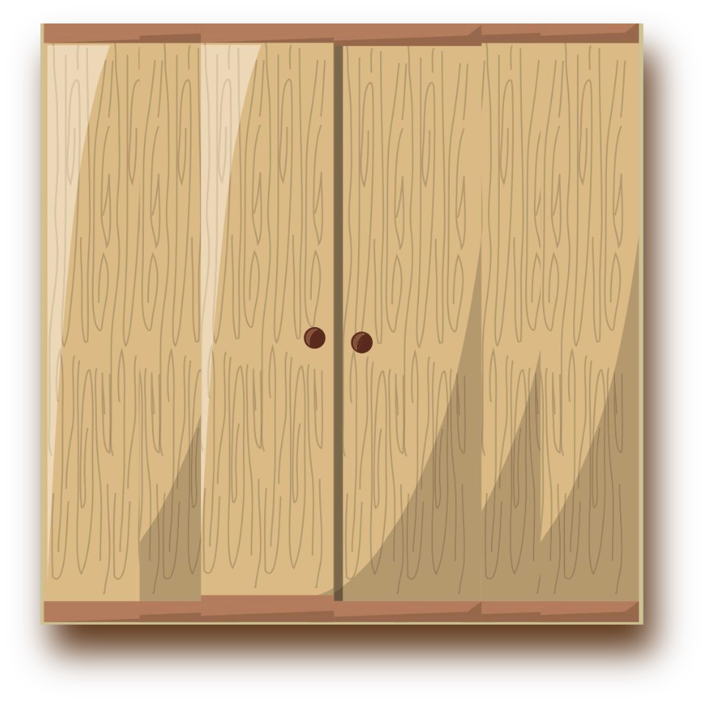

GORI

Slide 3

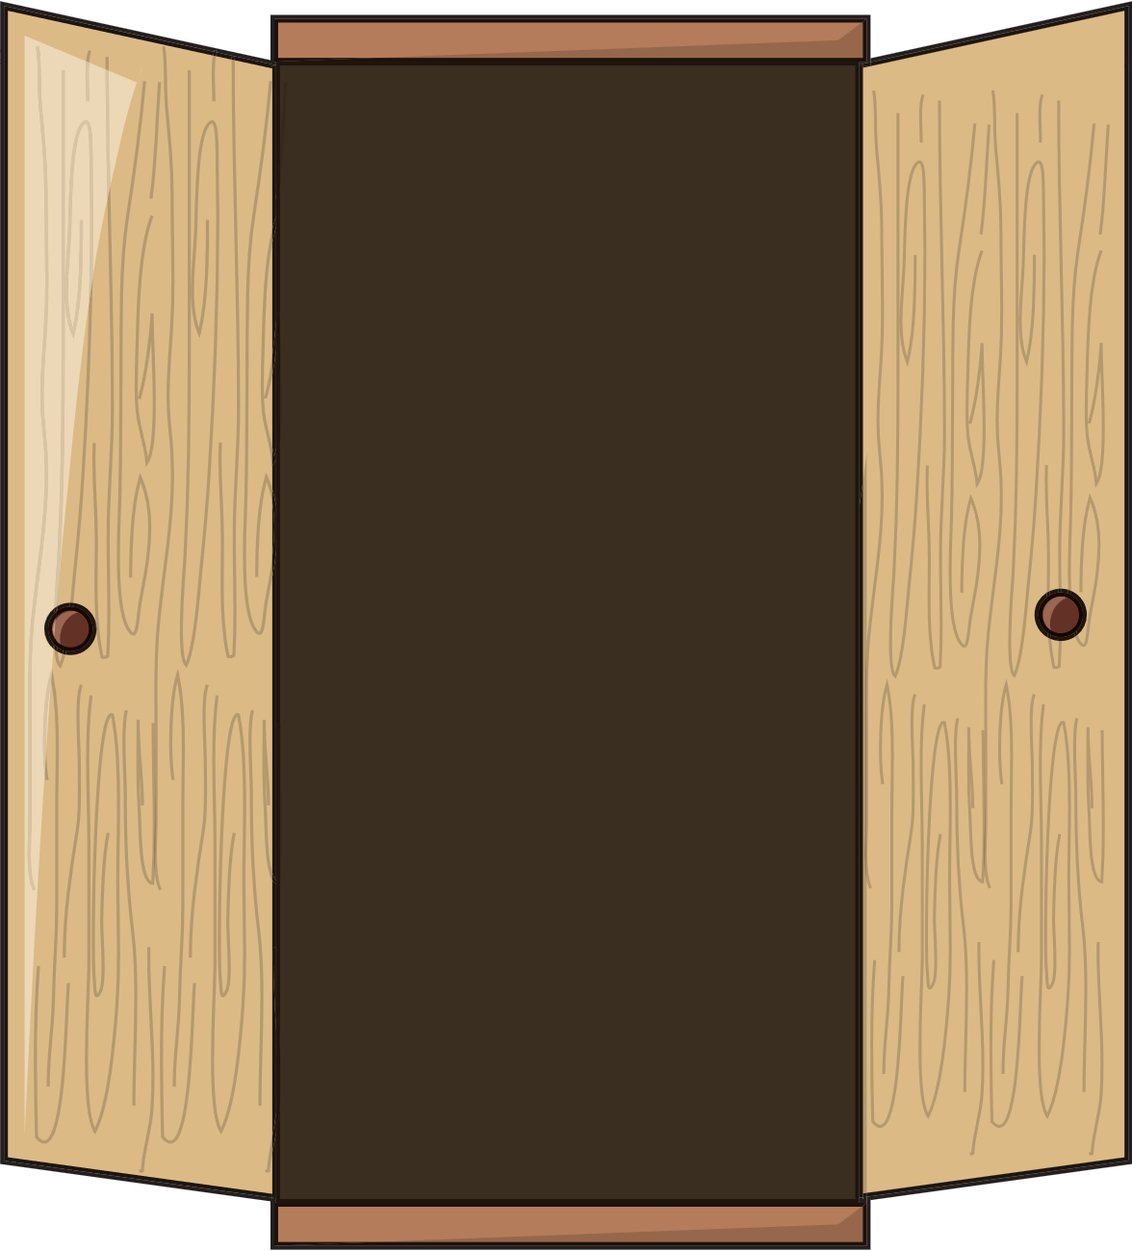

GORI
WARDROBE OF CONTENTS
The Team
Problem
Solutions
Determining Objects
Class Diagram
Classes
Project

Slide 4



GORI
THE
TEAM
Software developers and tech experts of Algorix a software development company that will handle the issue of counterfeited products

Slide 5









GORI
Jaru
Jezreel
Pearly
Razo
TEAM
Jennoele
THE

Slide 6


GORI
PRO
BLEM
Introduction of client and their problem

Slide 7
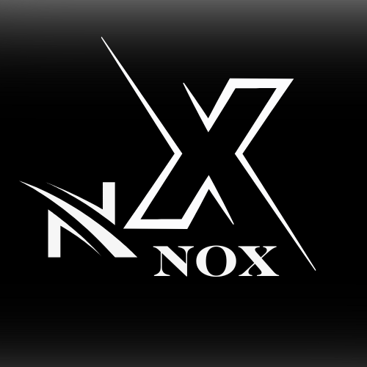

GORI
NOX
Apparel
the clothing line is facing a surge of counterfeit products, with fake versions of its designs appearing in unauthorized marketplaces, threatening brand integrity and customer trust.
PRO
BLEM

Slide 8
GORI
CAU
SES
possible factors that leads to counterfeited products

Slide 9

GORI
POSSIBLE CAUSES
Consumer Demand for Cheaper Alternatives
Corruption in Supply Chain
Lack of Brand Authentication Standards
Global Trade and Distribution Challenges
Insufficient Penalties for Counterfeiting
Lack of Collaboration Between Brands and Platform
Misleading Marketing by Counterfeiters
CAU
SES

Slide 10
GORI
POSSIBLE CAUSES
Online Marketplace Vulnerabilities
Limited Stocks
Lack of Brand Protection
Lack of Customer Awareness
Unauthorized Sellers
Weak Supply Chain Tracking
Lack of Regulatory Enforcement
Counterfeit Production Technology
CAU
SES

Slide 11
GORI
Online Marketplace Vulnerabilities
Limited Stocks
Lack of Brand Protection
Lack of customer awareness
Unauthorized Sellers
Weak Supply Chain Tracking
CAU
SES WE CAN FIX

Slide 12
GORI
SOL
UTION
Implementing strategies to prevent counterfeit apparel and protect the brand.

Slide 13

GORI
QR Code
Unique
Serial Number
Blockchain Verification Link
Anti-Tamper Encryption
Manufacturing & Batch Details
Purchase Verification
Product Authentication Page
SOL
UTION

Slide 14


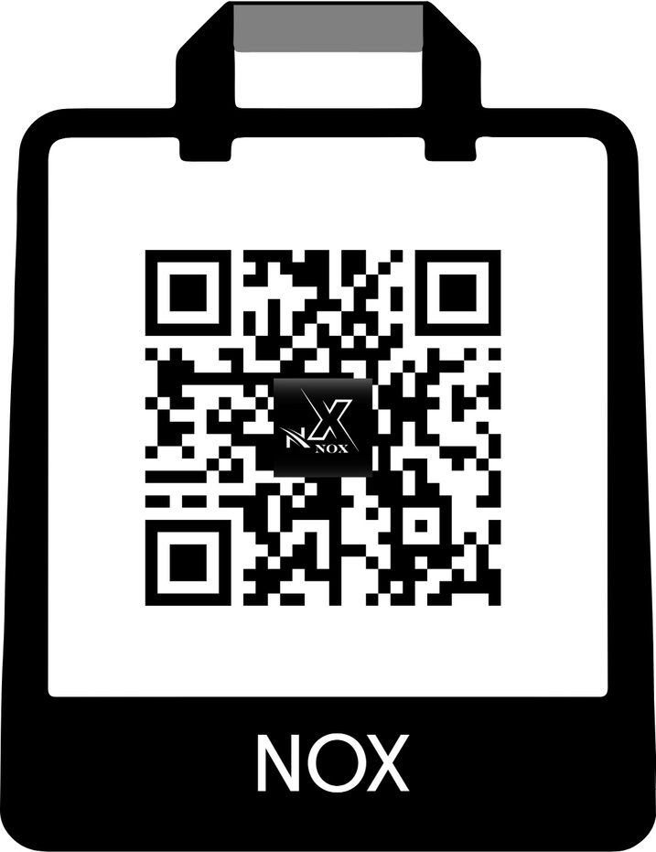


QR CODE
GORI
SCAN ME
SOL
UTION

Slide 15
GORI
Website
Product verification page
Stocks availability
Display of official store in e-commerce platforms
Feedback form
Link official social media accounts
Product photos with detailed shots to highlight original design
SOL
UTION

Slide 16
GORI
OBJ
ECTS
Identifying key elements involved in counterfeit detection and brand protection

Slide 17
GORI
ADS
Customer
Employee
Product
VerificatioN
Full Name, Age, Email Address, Password,
Gender,
Sex,
Address, Purchase History,
Loyalty Status
Employee ID, Name, Email Address,Password
Gender,
Sex,
Position, Work Schedule, Performance Score
Inclusive ,
Content,
Testimonials, Targeted Audience
Type, Model, Serial Number, Price, Stock, Authenticity Code
QR Scanner, Security Tags, Authentication Logs
Show Content, Attract Customers, Recommend,
Aware Customer
Browse products , Purchase, Leave Review , Verify Product
ManageOrders, AssistCustomers, TrackInventory
Purchase, Restock, Discount, Authenticate
ValidateProduct, PreventFraud, EducateCustomers
OB
JECTS

Slide 18
GORI
Reseller
Employment
record
Inventory
Reviews
Company
Reseller ID, Business Name, Email Address, Password,
Gender, Sex, Contract, Sales Volume
Employee ID, Position, Start Date, Contract Status
Product ID, Stock Level, Restock Alerts
Name, CEO, Brand Identity, Mission Statement
Review Content, Rating, Photos
DistributeProducts, MaintainQuality, ManageStock
TrackPerformance, UpdateRecords, GenerateReports
TrackStock, GenerateReport, PreventShortage
Submit Review, Engage Customers
MarketProducts, Partner With Resellers, Brand Protection
OB
JECTS

Slide 19
GORI
CLASS
DIA
GRAM
Illustrating system interactions for counterfeit prevention.

Slide 20
GORI
CLASS
DIA
GRAM

Slide 21
GORI
CLA
SSES
Defining the necessary classes to build an effective brand protection system.

Slide 22
GORI
CLA
SSES

Slide 23
GORI
PRO
JECTS
Implementing tech strategies to combat counterfeited products

Slide 24
GORI
The Tech Behind Our
Anti-Counterfeit Solution
Website Authentication System
QR Code Anti-Counterfeit System
Official NOX website for product verification.
Customers can check product authenticity before purchase.
Integrated with a secure e-commerce platform for direct sales.
Each product has a unique, scannable QR code.
Customers scan the QR code to verify authenticity.
Tracks product origin and supply chain movement.
PRO
JECTS

Slide 25

GORI
YOU
THANK

